Slide 1

OPEN SOURCE MOBILE PLATFORM
Android – Interface and Layout

Slide 2

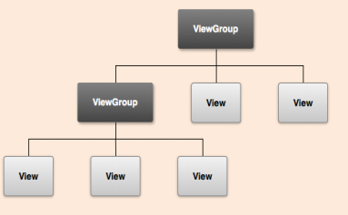
ANDROID GUI –THE CONCEPT
Your app's user interface is everything that the user can see and interact with. Android provides a variety of pre-built UI components such as structured layout objects and UI controls that allow you to build the graphical user interface for your app
Say Goodbye to the Menu Button
Implementing Effective Navigation
New Layout Widgets: Space and GridL ayout
Designing for Multiple Screens
Customizing the Action Bar

Slide 3
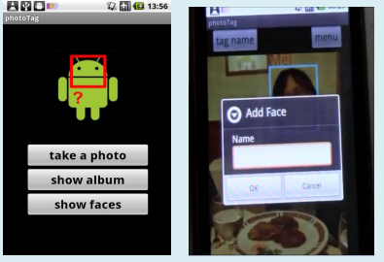
ANDROID GUI –THE CONCEPT
UI is build with of View and ViewGroup objects
A View is an object that draws something on the screen that the user can interact with
View = UI component (e.g. button, textfields,imageviews,..)
A ViewGroup is an object that holds other View (and ViewGroup) objects in order to define the layout of the interface.
ViewGroup containers that have a layout defined controlling how View widgets are arrange in it.

Slide 4
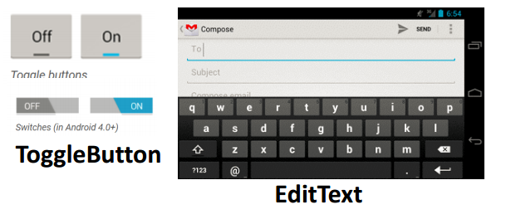
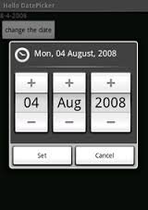
Views
android.view.View.* = base class for all Views.
example sub-classes include: TextView, ImageView, etc.

Slide 5
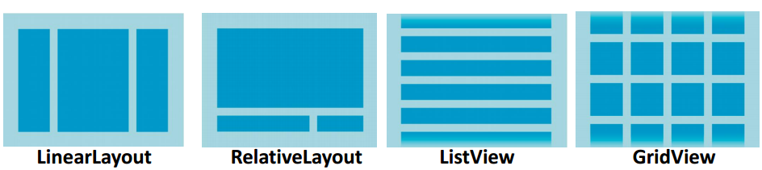
VIEWGROUP - SPECIFY LAYOUT
Controls location of Views in that ViewGroup
LinearLayout: all children aligned in single direction, horizontally or vertically
RelativeLayout: Child object relative to each other
ListView: a list of scrollable items
GridView: displays items in two-dimensional, scrollable grid

Slide 6
INTERFACES: TWO ALTERNATIVES FOR CREATION: CODE OR XML
You have two ways you can create the interface(s) of your Application.
Code = write code using SDK with classes like LinearLayout, TextView, ……
XML = create XML files in res/Layout (i.e. main.xml) that contain Android XML view tags like <LinearLayout> <TextView>, etc.

Slide 7
XML INTERFACE CREATION
Generally, I would say if it is possible, doing XML would be better as it means a decoupling of design from Java code.
You can have both in your system….
Lets discuss this first.
Layouts defined with XML located in res/layout

Slide 8
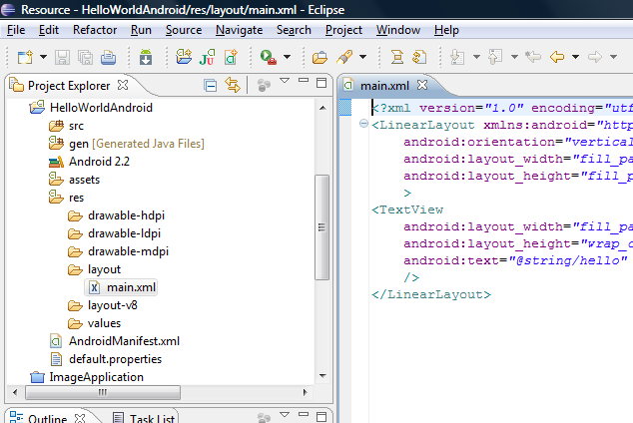
THE LAYOUT-THE INTERFACE
res/layout/main.xml = contains layout for interface
<?xml version="1.0" encoding="utf-8"?>
<LinearLayout xmlns:android="http://schemas.android.com/apk/res/android"
android:orientation="vertical"
android:layout_width="fill_parent"
android:layout_height="fill_parent"
>
<TextView
android:layout_width="fill_parent"
android:layout_height="wrap_content"
android:text="@string/hello"
/>
</LinearLayout>
The above will create an interface in vertical (versus portrait) mode that fills the parent
Both in width and write and wraps and content as necessary.

Slide 9
XML interface
it's a tree of XML elements,
Inspired by web authoring
Build up UI quickly
each node is the name of a View class (example is just one View element).
Create your own View ---extends
Each node can have multiple attributes
Look to API for details
Drag and drop
Call alter properties in Properties window

Slide 10
XML interface
<TextView xmlns:android="http://schemas.android.com/apk/res/android" android:layout_width="fill_parent" android:layout_height="fill_parent" android:text="@string/hello"/>
xmlns:android XML namespace declaration that tells the Android tools that you are going to refer to common attributes defined in the Android namespace. The outermost tag in every Android layout file must have this attribute.
android:layout_width This attribute defines how much of the available width on the screen this View should consume. As it's the only View so you want it to take up the entire screen, which is what a value of "fill_parent" means. android:layout_height This is just like android:layout_width, except that it refers to available screen height.
android:text This sets the text that the TextView should display. In this example, you use a string resource instead of a hard-coded string value. The hello string is defined in the res/values/strings.xml file.

Slide 11
Lets return to looking at some of the possible View Group Layouts

Slide 12
LINEAR LAYOUT
Determines how the layout is structured
LinearLayout
A Layout that arranges its children in a single column or a single row. The direction of the row can be set by calling setOrientation()/android orientation=”verticle”. You can also specify gravity, which specifies the alignment of all the child elements by calling setGravity() or specify that specific children grow to fill up any remaining space in the layout by setting the weight member of LinearLayout.LayoutParams. The default orientation is horizontal.
Good:
Simple
Know exactly how it will look on every device
Bad:
Well for many interfaces too simple….
BUT → see next slide
BUT, REMEMBER you can have a ViewGroup (another Layout) inside as a member of the LinearLayout to make a more COMPLEX interface

Slide 13
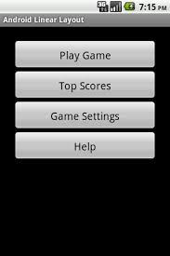
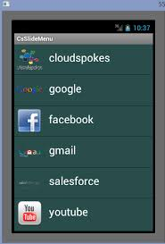
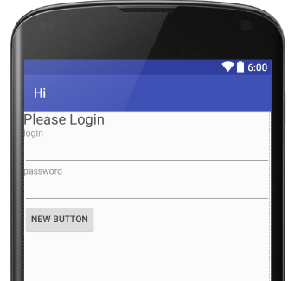
LINEARLAYOUT
Good for smaller devices (like phones over Tablets) or when simple interface makes sense
Layout in column (for Vertical) or row (for Horizontal) one after another child View objects

Slide 14
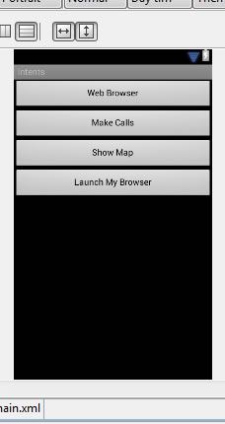
LinearLayout Example 2
<?xml version="1.0" encoding="utf-8"?> <LinearLayout xmlns:android="http://schemas.android.com/apk/res/android" android:layout_width="fill_parent" android:layout_height="fill_parent“ android:orientation="vertical" > <Button android:id="@+id/btn_webbrowser" android:layout_width="fill_parent" android:layout_height="wrap_content" android:text="Web Browser“ android:onClick="onClickWebBrowser" /> <Button android:id="@+id/btn_makecalls" android:layout_width="fill_parent" android:layout_height="wrap_content“ android:text="Make Calls" android:onClick="onClickMakeCalls" /> <Button android:id="@+id/btn_showMap" android:layout_width="fill_parent" android:layout_height="wrap_content“ android:text="Show Map" android:onClick="onClickShowMap" /> <Button android:id="@+id/btn_launchMyBrowser" android:layout_width="fill_parent" android:layout_height="wrap_content" android:text="Launch My Browser" android:onClick="onClickLaunchMyBrowser" /> </LinearLayout>
LinearLayout with 4 child View objects, all are buttons

Slide 15
Each View or ViewGroup can have its own set of attributes…but, some are very common
Attribute | Description
layout_width | specifies width of View or ViewGroup
layout_height | specifies height
layout_marginTop | extra space on top
layout_marginBottom | extra space on bottom side
layout_marginLeft | extra space on left side
layout_marginRight | extra space on right side
layout_gravity | how child views are positioned
layout_weight | how much extra space in layout should be allocated to View (only when in LinearLayout or TableView)
layout_x | x-coordinate
layout_y | y-coordinate

Slide 16
LINEARLAYOUT XML ATTRIBUTES & THE JAVA CLASS’S CORRESPONDING METHODS
android:baselineAligned setBaselineAligned(boolean) When set to false, prevents the layout from aligning its children's baselines.
android:baselineAlignedChildIndex setBaselineAlignedChildIndex(int) When a linear layout is part of another layout that is baseline aligned, it can specify which of its children to baseline align to (that is, which child TextView).
android:gravity setGravity(int) Specifies how to place the content of an object, both on the x- and y-axis, within the object itself.
android:measureWithLargestChild When set to true, all children with a weight will be considered having the minimum size of the largest child.
android:orientation setOrientation(int) Should the layout be a column or a row? Use "horizontal" for a row, "vertical" for a column.
android:weightSum Defines the maximum weight sum.

Slide 17
What about more complex interfaces?
…..yes you can do this especially with Nested Layouts

Slide 18
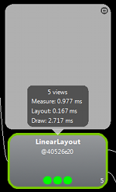
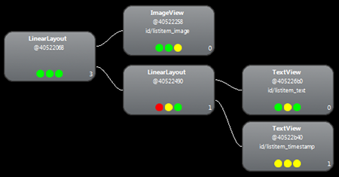
More Complexity →Example of Nested LinearLayouts
We have First LinearLayout (vertical) that contains ImageView and then another LinearLayout (inside it has 2 TextViews)
ImageView
2 TextViews

Slide 19
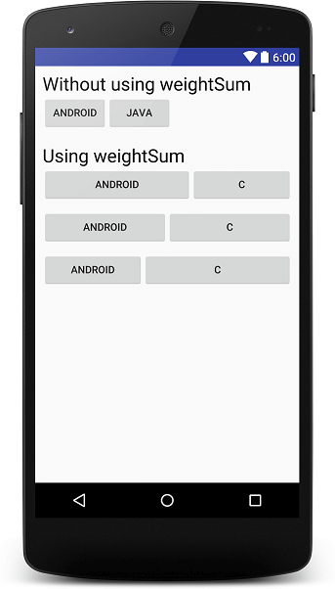
<?xml version="1.0" encoding="utf-8"?>
<LinearLayout xmlns:android="http://schemas.android.com/apk/res/android"
android:layout_width="match_parent"
android:layout_height="match_parent"
android:layout_margin="10dp"
android:orientation="vertical">
<TextView
android:layout_width="wrap_content"
android:layout_height="wrap_content"
android:text="Without using weightSum"
android:textColor="@android:color/black"
android:textSize="25sp" />
<LinearLayout
android:layout_width="match_parent"
android:layout_height="wrap_content"
android:orientation="horizontal">
<Button
android:layout_width="wrap_content"
android:layout_height="wrap_content"
android:text="Android" />
<Button
android:layout_width="wrap_content"
android:layout_height="wrap_content"
android:text="Java" />
</LinearLayout>
Another Nested LinearLayout Example
<TextView
android:layout_width="wrap_content"
android:layout_height="wrap_content"
android:layout_marginTop="20dp"
android:text="Using weightSum"
android:textColor="@android:color/black"
android:textSize="25sp" />
<LinearLayout
android:layout_width="match_parent"
android:layout_height="wrap_content"
android:orientation="horizontal"
android:weightSum="1">
<Button
android:layout_width="wrap_content"
android:layout_height="wrap_content"
android:layout_weight="0.7"
android:text="Android" />
<Button
android:layout_width="wrap_content"
android:layout_height="wrap_content"
android:layout_weight="0.3"
android:text="C" /> </LinearLayout>
<LinearLayout
android:layout_width="match_parent"
android:layout_height="wrap_content"
android:layout_marginTop="10dp"
android:orientation="horizontal"
android:weightSum="1">
<Button
android:layout_width="wrap_content"
android:layout_height="wrap_content"
android:layout_weight="0.5"
android:text="Android" />
<Button
android:layout_width="wrap_content"
android:layout_height="wrap_content"
android:layout_weight="0.5"
android:text="C" />
</LinearLayout>
<LinearLayout
android:layout_width="match_parent"
android:layout_height="wrap_content"
android:layout_marginTop="10dp"
android:orientation="horizontal"
android:weightSum="1">
<Button
android:layout_width="wrap_content"
android:layout_height="wrap_content"
android:layout_weight="0.2"
android:text="Android" />
<Button
android:layout_width="wrap_content"
android:layout_height="wrap_content"
android:layout_weight="0.8"
android:text="C" />
</LinearLayout>
</LinearLayout>
There are 3 LinearLayouts nested inside the outer LinearLayout

Slide 20
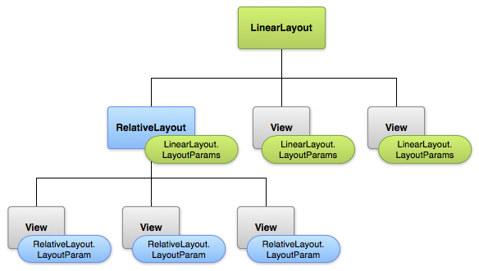
YOU CAN NEST ANY KIND OF LAYOUTS
you can have a ViewGroup (another Layout) inside as a member of the LinearLayout to make a more COMPLEX interface

Slide 21
Whatever Layout you choose it can contain Views and even other Layouts
As we see here we have an Interface that looks overall as a LinearLayout
It contains 2 Views and 1 RelativeLayout
The RelativeLayout contains 3 Views

Slide 22
ANOTHER OPTION TO GET COMPLEXITY → WHAT ABOUT OTHER LAYOUTS
RelativeLayout is good ---and can make your design EASIER. Elements based on relationship with another and with parent container. This is most complicated layout, it needs several properties to actually get the layout we want.
A RelativeLayout is a very powerful utility for designing a user interface because it can eliminate nested view groups and keep your layout hierarchy flat, which improves performance. If you find yourself using several nested LinearLayout groups, you may be able to replace them with a single RelativeLayout
Layout align_Parent botton, parent left, etc Properties:
Relative to other elements(android layout_above), align with other elements(layout assign baseline)

Slide 23

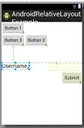
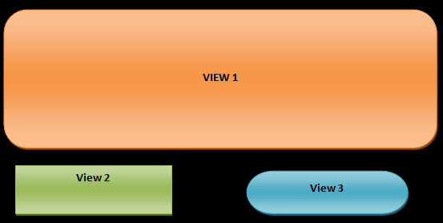
RelativeLayout
GOOD:
Can give more complex interfaces
Know what will look like on different sized devices
Position relative to another position
CAUTION This is meant to be flat –meaning you don’t want/need to nest RelativeLayouts in each other –sometimes may impact speed in rendering and some have reported problems.

Slide 24

RelativeLayout How it works
Parameters in XML (or can map to method calls in Java RelativeLayout class)
Position relative to Parent
android:layout_alignParentTop, android:layout_alignParentBottom, android:layout_alignParentLeft, android:layout_alignParentRight VALUE = ‘true’ ---If "true", moves to that edge of Parent android:layout_centerVertical VALUE= “true” -- If "true", centers this child vertically within its parent.
Position relative to another widget
android:layout_below, android:layout_above, android:layout_toLeftOf, android:layout_toRightOf
VALUE=“resource ID of other widget” -- Positions the top edge of this view below/above of the view specified with a resource ID.
OR Positions the left edge of this view to the left/right of the view specified with a resource ID.

Slide 25
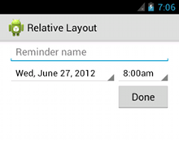
RelativeLayout – how it works
Example
<?xml version="1.0" encoding="utf-8"?> <RelativeLayout xmlns:android="http://schemas.android.com/apk/res/android" android:layout_width="match_parent" android:layout_height="match_parent" android:paddingLeft="16dp" android:paddingRight="16dp" > <EditText android:id="@+id/name" android:layout_width="match_parent" android:layout_height="wrap_content" android:hint="@string/reminder" /> <Spinner android:id="@+id/dates" android:layout_width="0dp" android:layout_height="wrap_content" android:layout_below="@id/name" android:layout_alignParentLeft="true" android:layout_toLeftOf="@+id/times" /> <Spinner android:id="@id/times" android:layout_width="96dp" android:layout_height="wrap_content" android:layout_below="@id/name" android:layout_alignParentRight="true" /> <Button android:layout_width="96dp" android:layout_height="wrap_content" android:layout_below="@id/times" android:layout_alignParentRight="true" android:text="@string/done" /> </RelativeLayout>
Says we have RelativeLayout that width and height match parent (which is the entire app screen)
1st View object in RelativeLayout will be at the top and is the EditText
2nd View object here is specified to be below the 1st object EditText (id = name) & aligned to left of parent(app) & Left of the Button with id=times (see below)
3rd View object here is specified to be below the 1st object EditText (id = name) & aligned to left of parent(app)
4th View object here is specified to be below the 2nd object Spinner (id = times)
& aligned to right of parent(app)

Slide 26
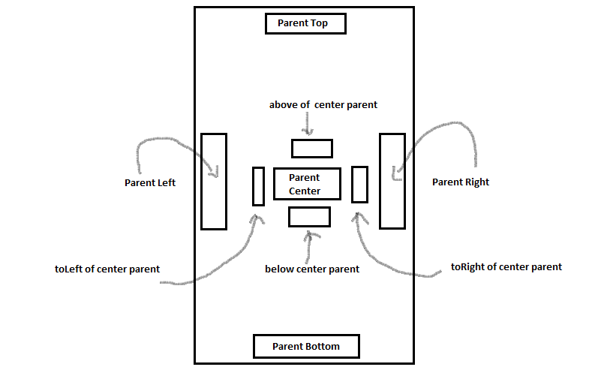
More on RelativeLayout parameters
Center Top Bottom of Parent

Slide 27

There are many other Layouts
They include: TableLayout (think a table), GridLayout, FrameLayout, and MORE!!
TableLayout
Read book and look at developer website to learn about others like TableLayout

Slide 28
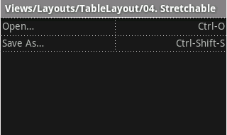
TableLayout Example
<?xml version="1.0" encoding="utf-8"?> <TableLayout xmlns:android="http://schemas.android.com/apk/res/android" android:layout_width="match_parent" android:layout_height="match_parent" android:stretchColumns="1"> <TableRow> <TextView android:text="@string/table_layout_4_open" android:padding="3dip" /> <TextView android:text="@string/table_layout_4_open_shortcut" android:gravity="right" android:padding="3dip" /> </TableRow> <TableRow> <TextView android:text="@string/table_layout_4_save" android:padding="3dip" /> <TextView android:text="@string/table_layout_4_save_shortcut" android:gravity="right" android:padding="3dip" /> </TableRow> </TableLayout>
This Table has 2 Rows

Slide 29
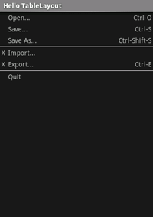
TableLayout example 2
Here use gravity to move the 2nd item in row to the right
ONLY partial XML code
<?xml version="1.0" encoding="utf-8"?> <TableLayout xmlns:android="http://schemas.android.com/apk/res/android" android:layout_width="match_parent" android:layout_height="match_parent" android:stretchColumns="1"> <TableRow> <TextView android:layout_column="1" android:text="Open..." android:padding="3dip" /> <TextView android:text="Ctrl-O" android:gravity="right" android:padding="3dip" /> </TableRow> <TableRow> NOW CONTINUE ON FOR 2nd row

Slide 30
Do different Layouts have better performance???
…..actually yes they can

Slide 31
CAUTION --- speed of rendering can be impacted by design choices
Nesting several instances of LinearLayout that use the layout_weight parameter can be especially expensive as each child needs to be measured twice.

Slide 32

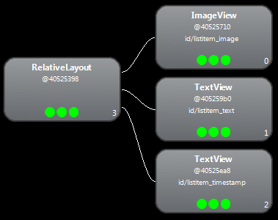
Comparing speeds: Nested LinearLayout VERSUS RelativeLayout
Nested LinearLayout RelativeLayout
speed: speed:
Measure: 0.977ms
Layout: 0.167ms
Draw: 2.717ms
Measure: 0.598ms
Layout: 0.110ms
Draw: 2.146ms
RelativeLayout is FASTER

Slide 33
More on improving performance
Go to Developer site and search on “Improving Layout Performance”
https://developer.android.com/training/improving-layouts/index.html

Slide 34
Related Layout Tags
to create a DYNAMIC layout contents –one where the contents are dynamic (maybe reading from database or???)
→ Subclasses of AdapterView

Slide 35
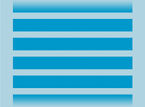
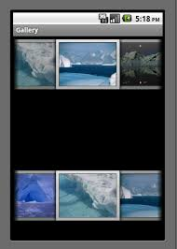

SOME Examples of Layout Tags that can load contents/data dynamically
ListView Gallery GridView
All these (and there are more) are descendants of AdapterView

Slide 36
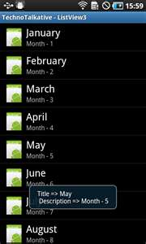
ListView <ListView …..>
A view that shows items in a vertically scrolling list.
Attributes
android:divider Drawable or color to draw between list items.
android:dividerHeight Height of the divider.
android:entries Reference to an array resource that will populate the ListView.
android:footerDividersEnabled When set to false, the ListView will not draw the divider before each footer view.
android:headerDividersEnabled When set to false, the ListView will not draw the divider after each header view.

Slide 37
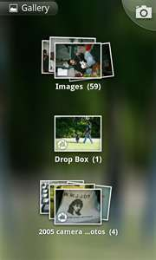
Gallery <Gallery ….>
A view that shows items in a center-locked, horizontally scrolling list.
The default values for the Gallery assume you will be using Theme_galleryItemBackground as the background for each View given to the Gallery from the Adapter. If you are not doing this, you may need to adjust some Gallery properties, such as the spacing.
Attributes
android:animationDuration setAnimationDuration(int) Sets how long a transition animation should run (in milliseconds) when layout has changed.
android:gravity setGravity(int) Specifies how to place the content of an object, both on the x- and y-axis, within the object itself.
android:spacing setSpacing(int)
android:unselectedAlpha setUnselectedAlpha(float) Sets the alpha on the items that are not selected.

Slide 38
Code—setting up Gallery
@Override public void onCreate(Bundle savedInstanceState) { super.onCreate(savedInstanceState); setContentView(R.layout.main); //use xml file that contain a <Gallery> Gallery gallery = (Gallery) findViewById(R.id.gallery); gallery.setAdapter(new ImageAdapter(this)); gallery.setOnItemClickListener(new OnItemClickListener() { public void onItemClick(AdapterView parent, View v, int position, long id) { Toast.makeText(HelloGallery.this, "" + position, Toast.LENGTH_SHORT).show(); } }); }
We need a “HANDLE” to the Gallery we created from XML in our Java code to handle events when an item in Gallery is clicked on

Slide 39
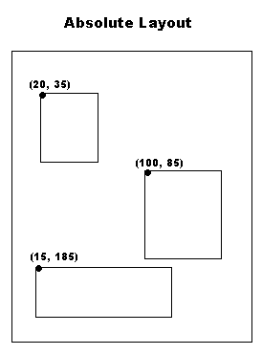
Note there is also Absolute Layout
You position View widgets exactly where you want them.
It is DEPRECATED
Great for fast creation of GUI –NOT GOOD for changing GUI dimension between different devices → that is why we have other different “controlled” layouts like LinearLayout, RelativeLayout and others

Slide 40
Assignment 1 CSE G&G 5th SEM 4/9/2017 Batch B1,2
1. What is Activity, How is it Created ?
2. Describe the role of Intent and different types of intents in Android programming?
3. What are view and view groups ?
2. Explain Fragments in Android Programming ?

